Slide 1
A Neural Oscillator for Position Controlled Joints
Independent Study
Sayantan Auddy
Advisor – Dr. Sven Magg

Slide 2

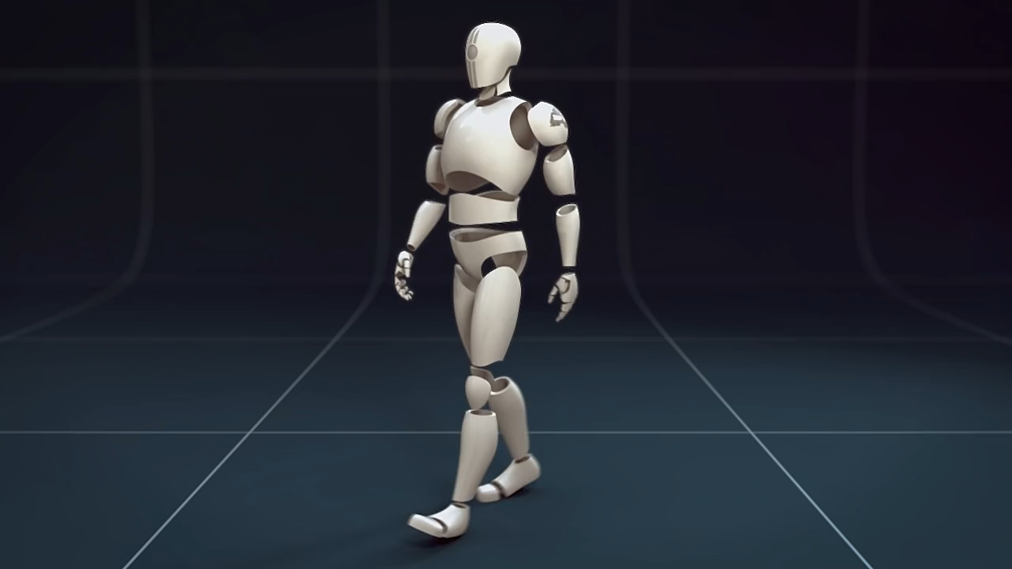
Motivation
The big picture
[https://youtu.be/_kzgk4Rnpqc]
[https://vimeo.com/59197431]
The specific problem
Torque controlled robot
Neural oscillator
Torque output
Simulation
model

Slide 3
Outline
Biological background
Matsuoka oscillator
Coupling multiple oscillators
Joint control using Matsuoka oscillator
Joint control demonstration
Future work (master thesis spot talk)

Slide 4
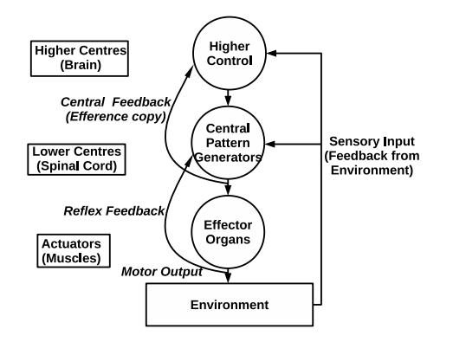
Biological Background
Neural Circuits (CPG) exist in the spinal cord
Rhythmic patterns produced without rhythmic input
Sensory feedback used for modulation
Neural components of motor systems
[Shepherd, 1994]

Slide 5
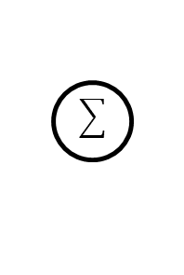
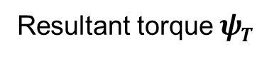
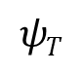
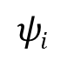
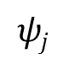
Half-center neuron model
Proposed by Brown to explain movements of a decerebrated cat
Self and mutual inhibition leads to switching of activity
[Brown, 1914]
CPG
$$ψi$$
t
i
Activation of i
Resultant torque $ψT$
+
D
$$ψT$$
t
-
j
Activation of j
$$ψj$$
t
Driving neuron pool
Interneuron pool
Inhibitory connection
Excitatory connection
Notes:
Add waveform
Mention torque

Slide 6
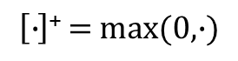
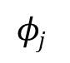
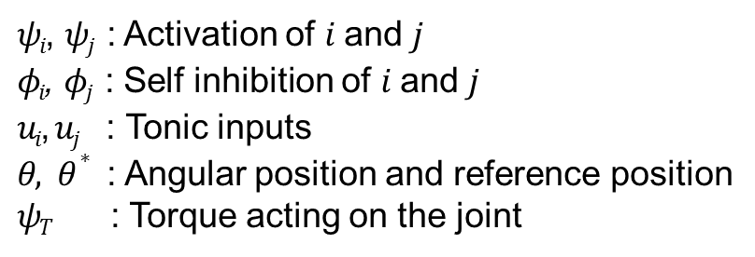

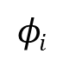
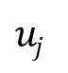
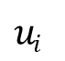



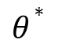

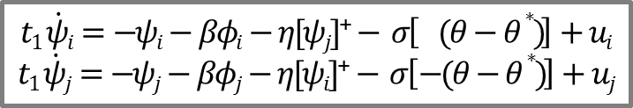
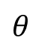
Matsuoka Oscillator
Mathematical model of neural rhythm generators
Based on a piece-wise linear set differential equations
[Matsuoka, 1985, 1987]
[Ronsse, 2009]
Feedback
$$φi$$
Proprioceptive
feedback
$$t1 \dot{ψi}=−ψi−βφi−η[ψj]\text{+}− σ\left[ (θ−θ∗ )\right]+ui$$
$$t1 \dot{ψj}=−ψj−βφj−η[ψi]\text{+}− σ\left[−(θ−θ∗ )\right]+uj$$
$$ui$$
$$ψi$$
D
$t2 \dot{φi}=−φi+[ψi]$⁺
$t2 \dot{φj}=−φj+[ψj]$⁺
$$uj$$
$$θ$$
$$ψj$$
$$φj$$
$θ∗$
$$ψT=hψ([ψi]\text{+}−[ψj]\text{+})$$
$$I\ddot{θ}+γ\dot{θ}−ψT=0$$
$ψi$, $ψj$ : Activation of $i$ and $j$
$φi$, $φj$ : Self inhibition of $i$ and $j$
$ui$, $uj$ : Tonic inputs
$θ, θ∗$ : Angular position and reference position
$ψT$ : Torque acting on the joint
$$\left[∙\right]\text{+}=max(0,∙)$$
Notes:
Feedback is in terms of angle, not torque

Slide 7


Output Pattern Modulation
Joint torques
Joint angles
-- joint angle
-- reference position
Reference angle $θ^{∗}$ varied
(0 to 1 to -1 radians)
Tonic inputs $u_{i},u_{j }$varied from 1.0 to 4.0

Slide 8
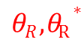

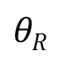
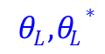

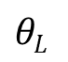
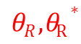
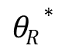
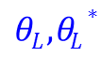
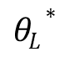
Coupling of oscillators
$θR , θR∗$
i
$θL , θL∗$
D
$$\text{j}$$
$$θL$$
Coupling at the level of output variables
$$θL∗$$
$$θR∗$$
j
$$θR$$
D
$$i$$
$θR , θR∗$
$θL , θL∗$
[Ronsse, 2009]

Slide 9
Anti-phase / in-phase oscillations
Anti-phase
In-phase

Slide 10
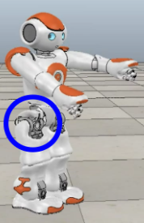

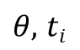
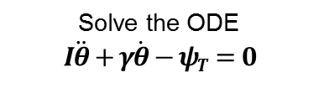
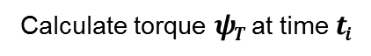
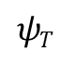
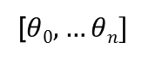

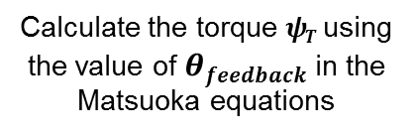
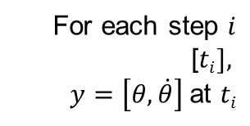
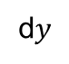

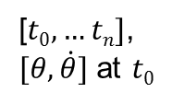
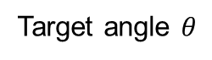
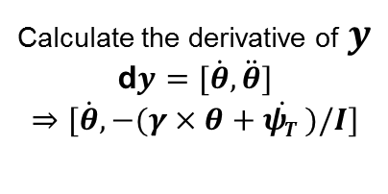
Robot Joint Control
Initialization
Mechanical Inertial System
Initialize the joint
For each step $i$
[$ti],$
$y=\left[θ, \dot{θ}\right]$at $ti$
Set parameters $I, γ$
Set oscillator parameters
[$t0,…tn]$,
$[θ, \dot{θ}]$ at $t0$
Calculate torque $ψT$ at time $ti$
Set time steps
Calculate the derivative of $y$
d$y=[\dot{θ}, \ddot{θ}]$
$$⇒[\dot{θ}, −(γ×\dot{θ+ψT )/I]}$$
Solve the ODE
$$I\ddot{θ}+γ\dot{θ}−ψT=0$$
1
ODE
solver
2
8
7
[$θ0,…θn]$
d$y$
3
Robot Joint
2-7
6
$$ψT$$
$θ,$ $ti$
Target angle $θ$
Matsuoka Torque
4
Set joint to angle $θ$
Calculate the torque $ψT$ using the value of $θfeedback$ in the Matsuoka equations
5
Actual joint position $θfeedback$

Slide 11
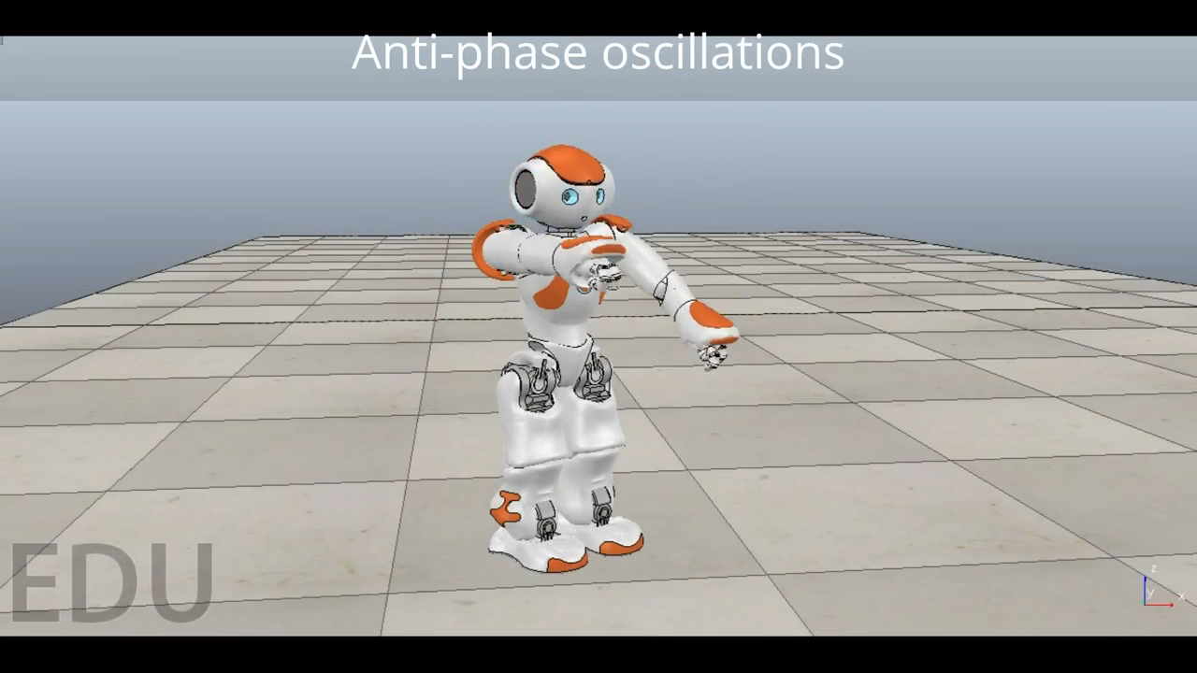
Joint Control Demonstration

Slide 12
Conclusion
Neural oscillators – alternative approach to walking
Use of Matsuoka oscillator limited to torque controlled robots
Presented joint control technique adapts Matsuoka oscillator to position controlled robots
Can serve as a base for a framework of bio-inspired, model-free, biped locomotion

Slide 13
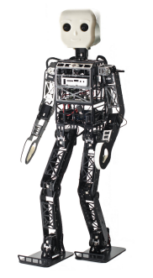
Future Work
Development of a bio-inspired framework for walking
Can be implemented on any position controlled robot
Uses Matsuoka oscillators for controlling joints
Balance maintained using a neural network based controller
Notes:
Network of oscillators to control leg and hip joints
Oscillator connections, number of parameters, symmetry
Find optimum parameters for oscillators for walking without feedback from vestibular sensors:
on a level surface
on an upward or downward slope
transitioning from a flat to a sloping surface
Balance control using vestibular sensors

Slide 14
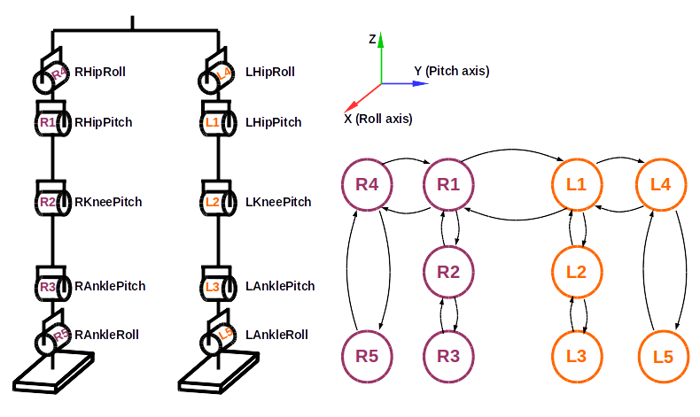
Neural oscillator network
R4
R1
L1
L4
R2
L2
R5
R3
L3
L5
Neural oscillator network controlling joints for walking
+
Adapted from [Kieboom, 2009]
PSO
Optimization of oscillator parameters using PSO variants (high dimensional problem spaces)
[Pant, 2007]

Slide 15
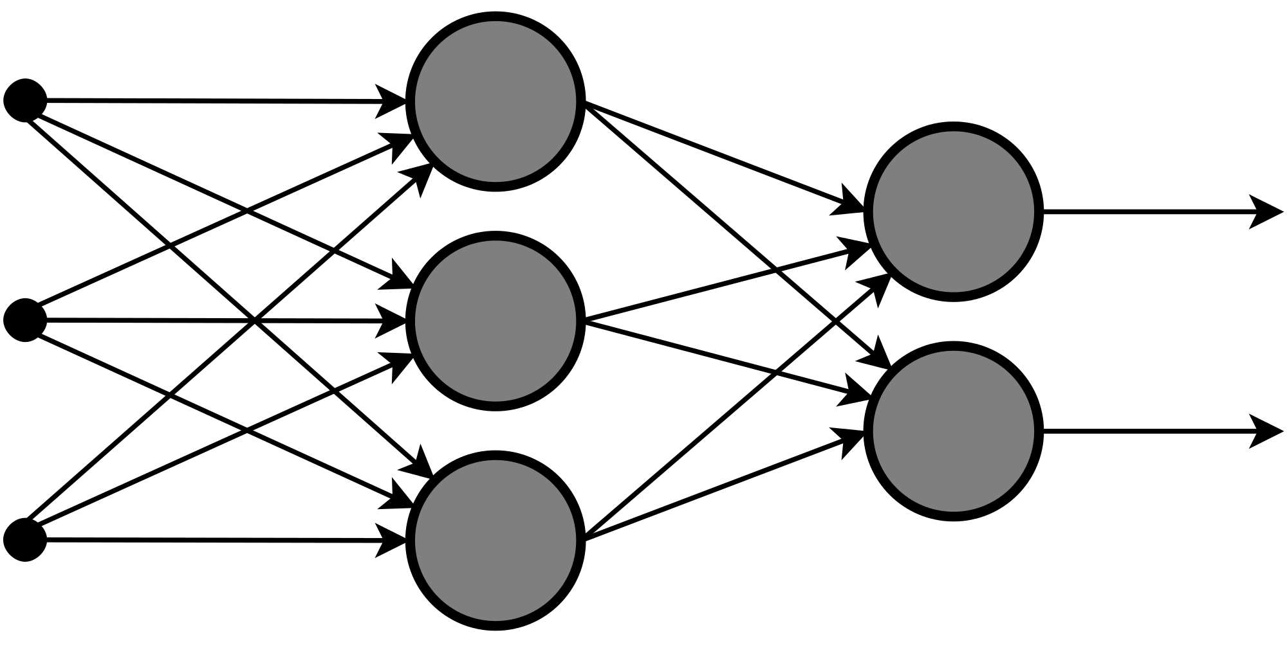
Balance Controller
Neural oscillator network
Walking speed/direction
R4
R1
L1
L4
Balance controller
Parameter adjustment
R2
L2
R5
R3
L3
L5
Target angles
Proprioceptive feedback
Filtered vestibular information
State Estimation
Vestibular information
Adapted from [Missura, 2015]
Biped robot
Notes:
Network of oscillators to control leg and hip joints
Oscillator connections, number of parameters, symmetry
Find optimum parameters for oscillators for walking without feedback from vestibular sensors:
on a level surface
on an upward or downward slope
transitioning from a flat to a sloping surface
Balance control using vestibular sensors

Slide 16
Literature
[Brown, 1914] T G Brown. On the nature of the fundamental activity of the nervous centres. The Journal of Physiology, 1914.
[Kieboom, 2009] J V D Kieboom. Biped Locomotion and Stability - A Practical Approach. Master’s thesis, University of Groningen, 2009.
[Matsuoka, 1985] K Matsuoka. Sustained oscillations generated by mutually inhibiting neurons with adaptation. Biological cybernetics, 1985.
[Matsuoka, 1987] K Matsuoka. Mechanisms of frequency and pattern control in the neural rhythm generators. Biological Cybernetics, 1987.
[Missura, 2015] M Missura and S Behnke. Gradient-driven online learning of bipedal push recovery. IROS, 2015.
[Pant, 2007] M Pant, T Radha, and V P Singh. A Simple Diversity Guided Particle Swarm Optimization. In IEEE Congress on Evolutionary Computation, 2007.
[Ronsse, 2009] R Ronsse, D Sternad, and P Lefevre. A computational model for rhythmic and discrete movements in uni-and bimanual coordination. Neural computation, 2009.
[Shepherd, 1994] Gordon M. Shepherd. Neurobiology. Oxford University Press, 1994.

Slide 17
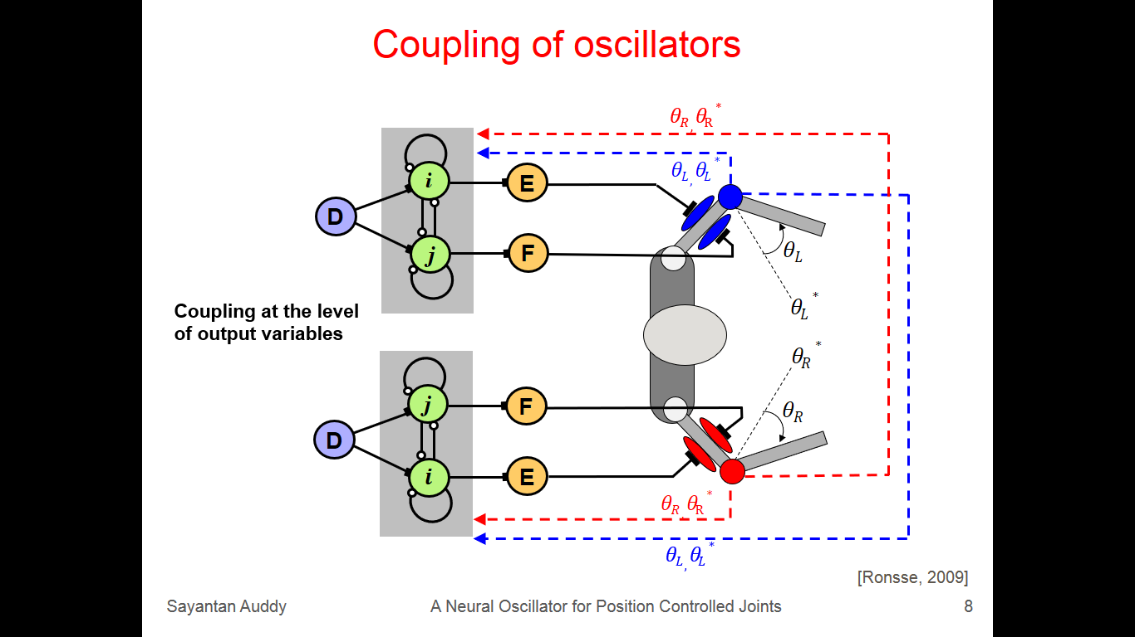
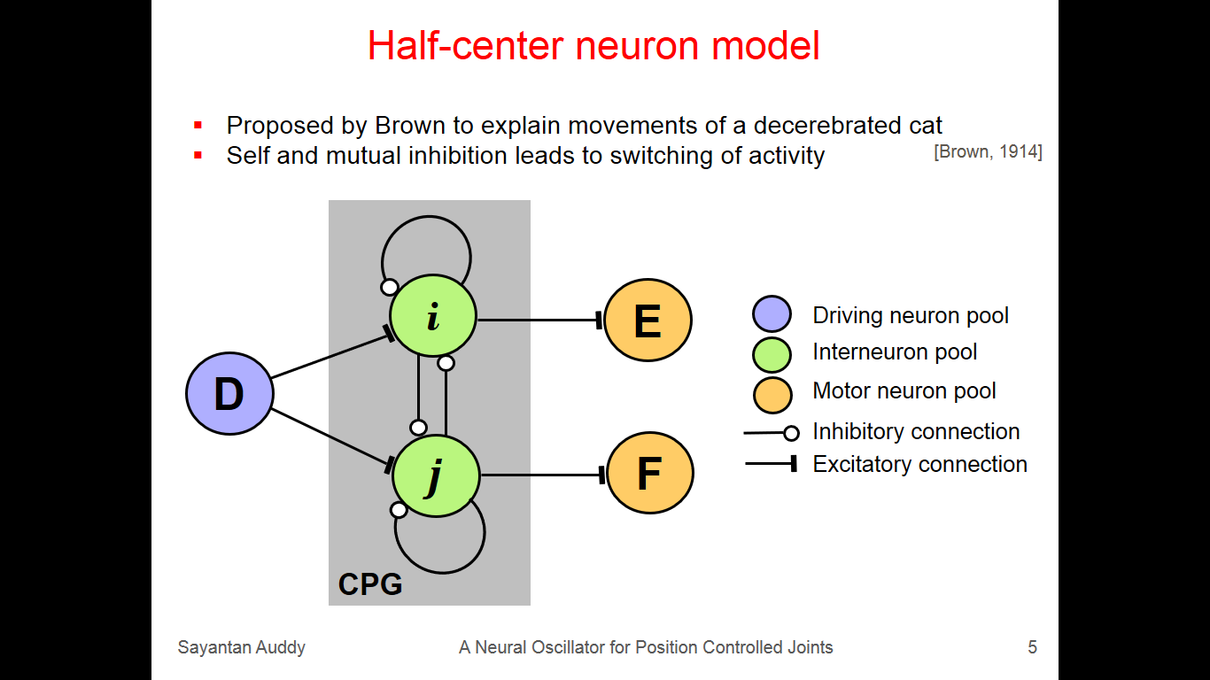
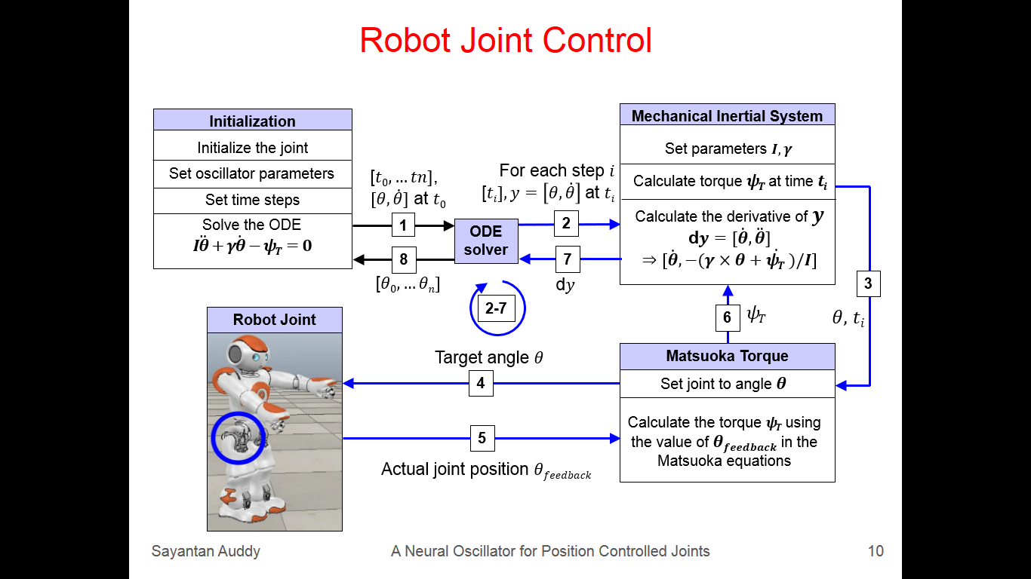
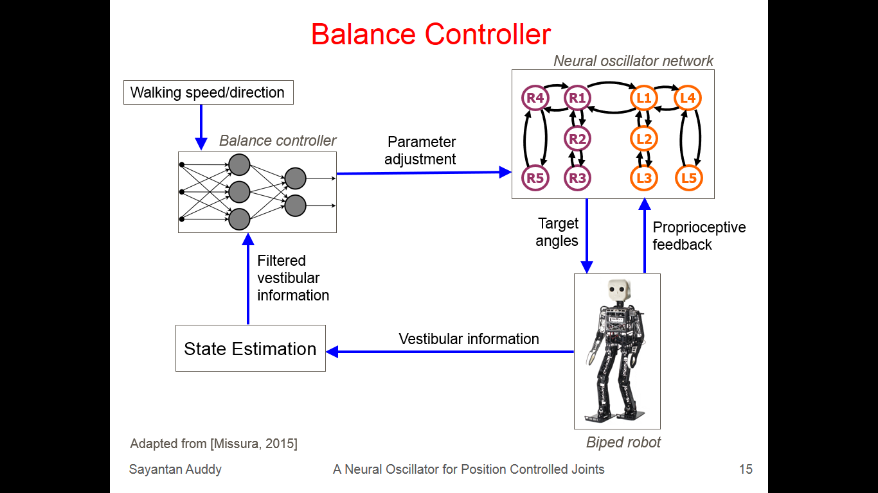
Thank you
Notes:
Slides 5, 8, 10, 15

Slide 18
Extra slides

Slide 19


Different Coupling Mechanisms
$θR , θR∗$
i
E
$θL , θL∗$
D
$$\text{j}$$
F
$$θL$$
Coupling at the level of internal state variables
$$θL∗$$
Coupling at the level of output variables
Coupling at the input level
$ψLi$, $ψLj$
$ψRi$, $ψRj$
$$θR∗$$
j
F
$$θR$$
D
$$i$$
E
$θR , θR∗$
$θL , θL∗$
[Ronsse, 2009]

Slide 20
Stable Attractors
Difference of activation (s)
Final phase difference (rad)
Time period of oscillation (s)

